Slide 1


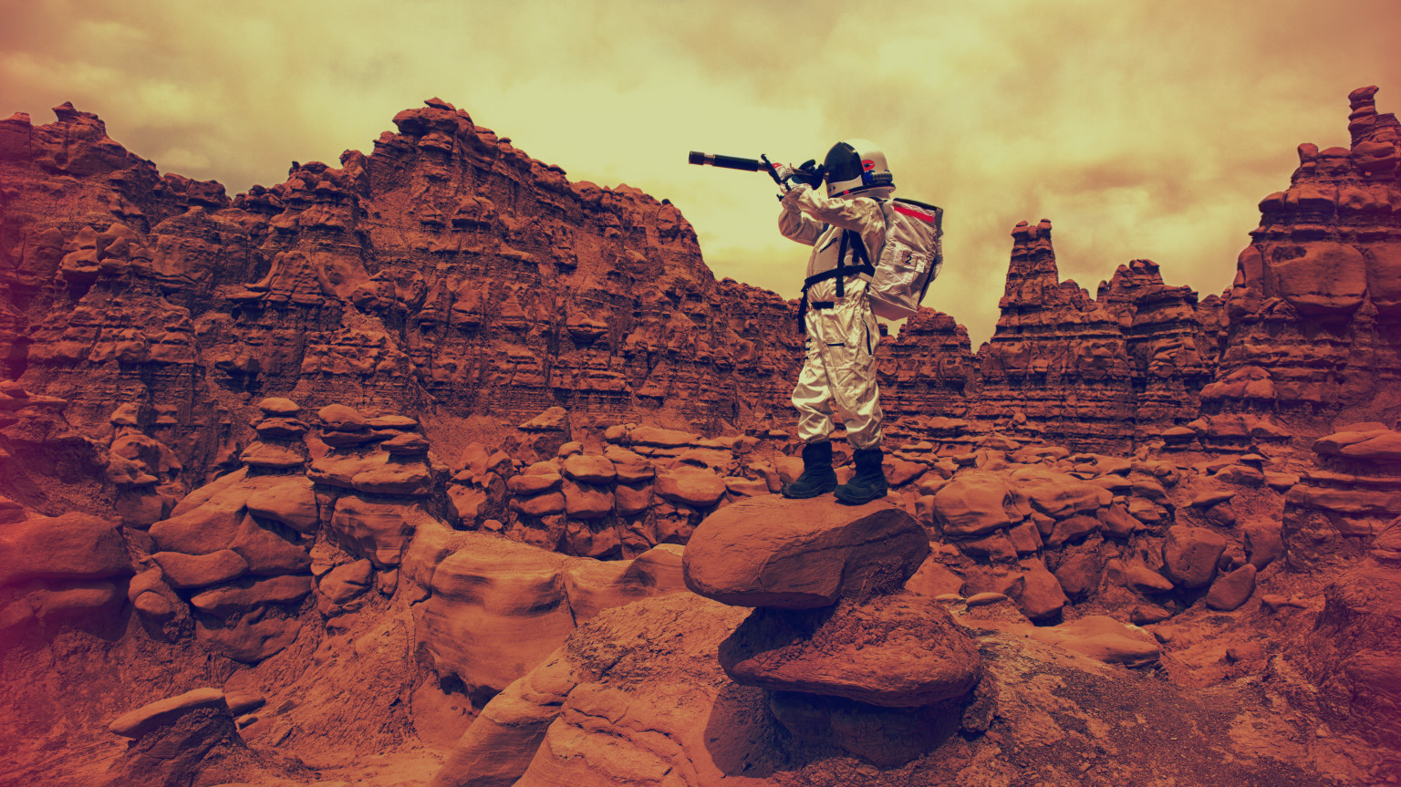

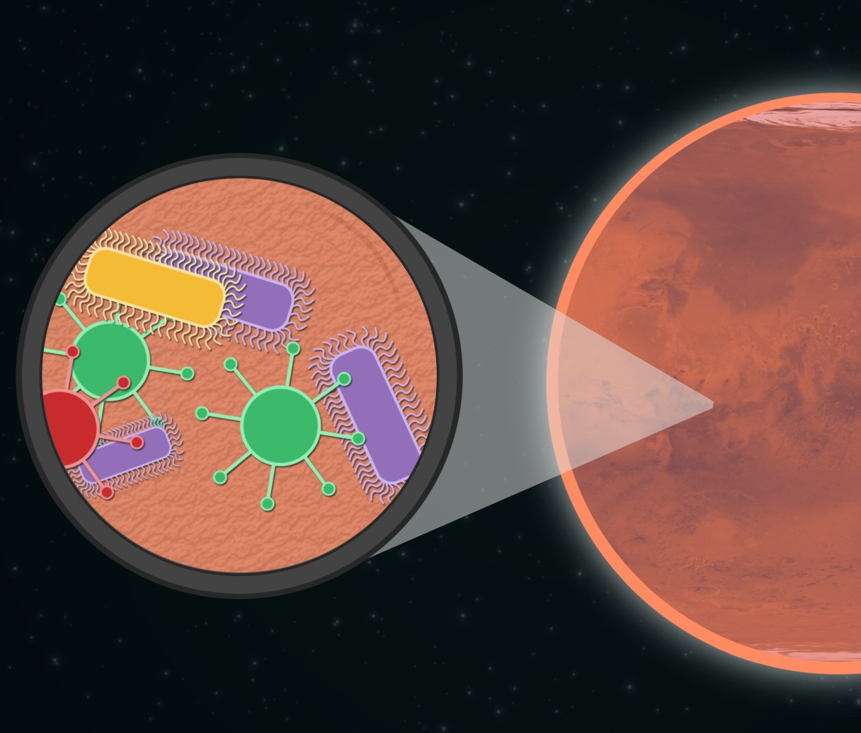
Mapping potential Life nest on Mars, using ArcgisPRO
TOUDJI Yanis
2020
RUDNed

Slide 2
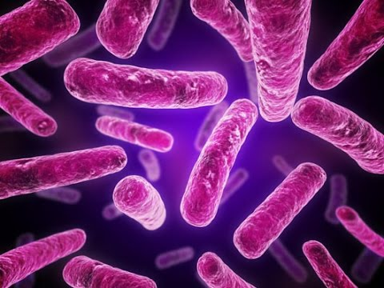
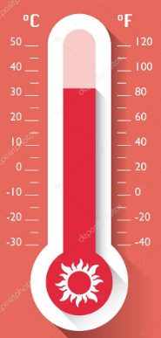
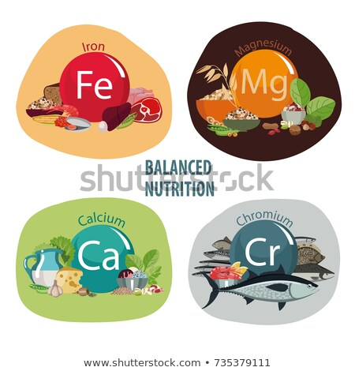

LIFE

Slide 3
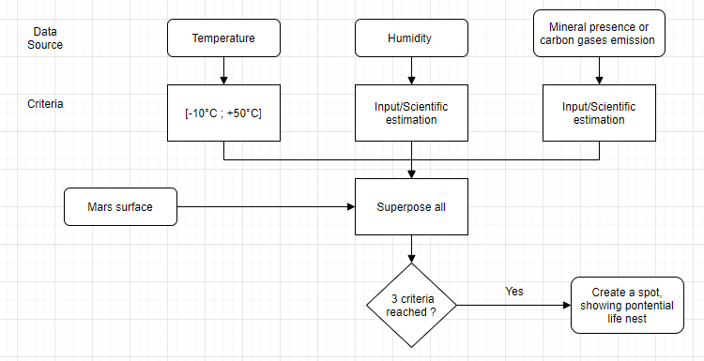
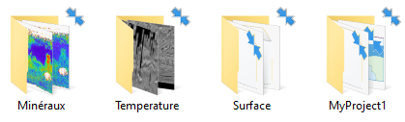
http://mars.asu.edu/data/

Slide 4
Retrieving data
Main Odyssey mission & THEMIS (Thermal Emission Imaging System) in 2001
http://mars.asu.edu/data/
Surface layer :
http://mars.asu.edu/data/molasr/
Temperature layer :
http://mars.asu.edu/data/thm_dir/
Mineral layer :
http://mars.asu.edu/data/tes_silicates/
http://mars.asu.edu/data/tes_kfeldspar/
http://mars.asu.edu/data/tes_plagioclase/

Slide 5
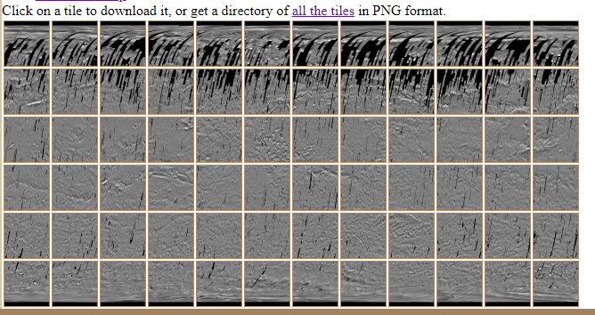
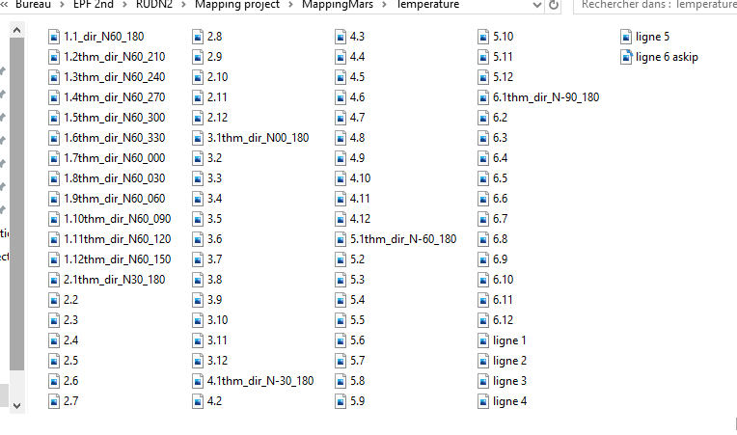
Temperature’s layer
72 files to merge together

Slide 6
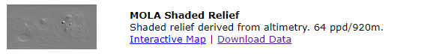
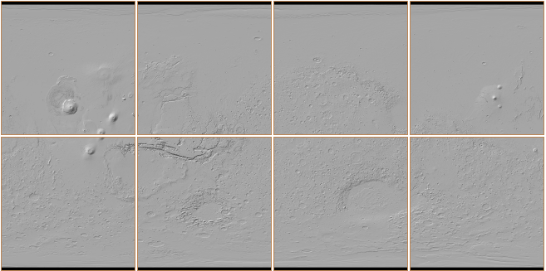
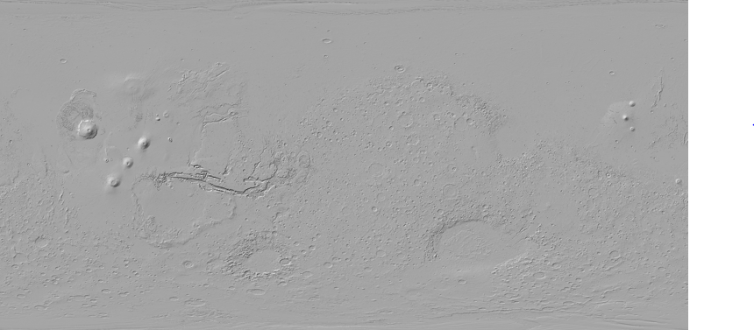
Surface’s layer

Slide 7
Vastitas borealis
Arabia
Olympus
Tharsis
Valles Marineris
Hellas
Argyre

Slide 8
Life sustainability of minerals
SILICATES
FELDSPAR
PLAGIOCLASE
HEMATITE
OLIVINE
AMPHIBOL…

Slide 9
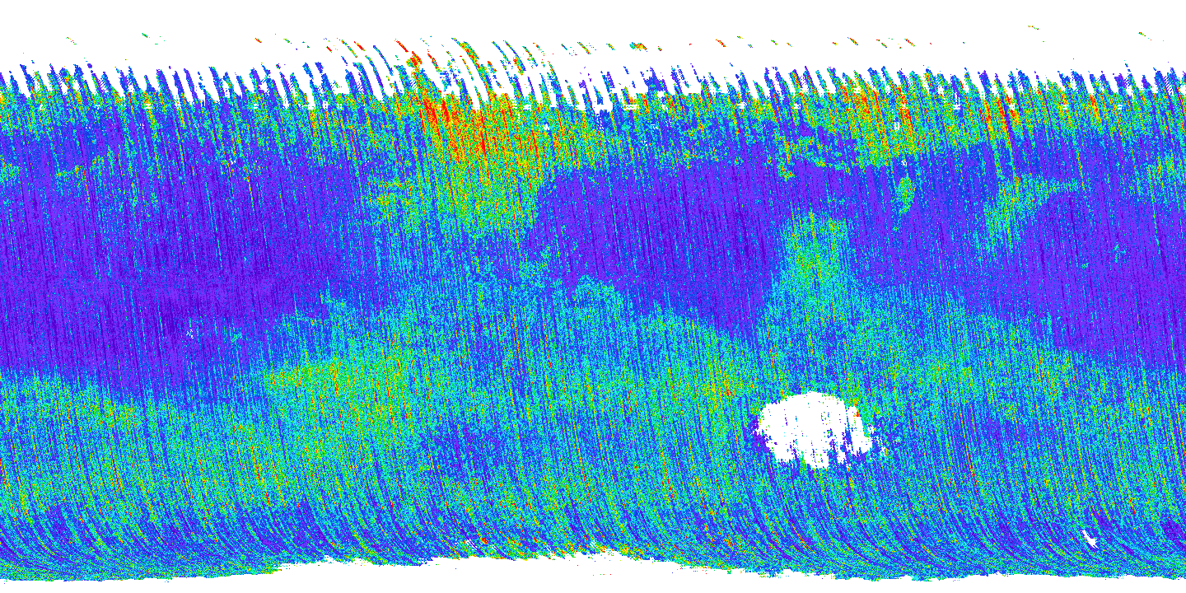

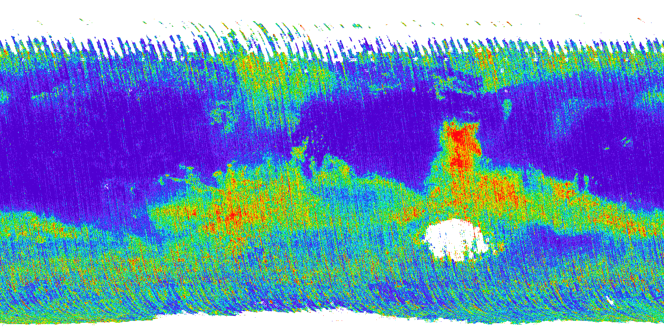
minerals
SILICATES
FELDSPAR
PLAGIOCLASE

Slide 10
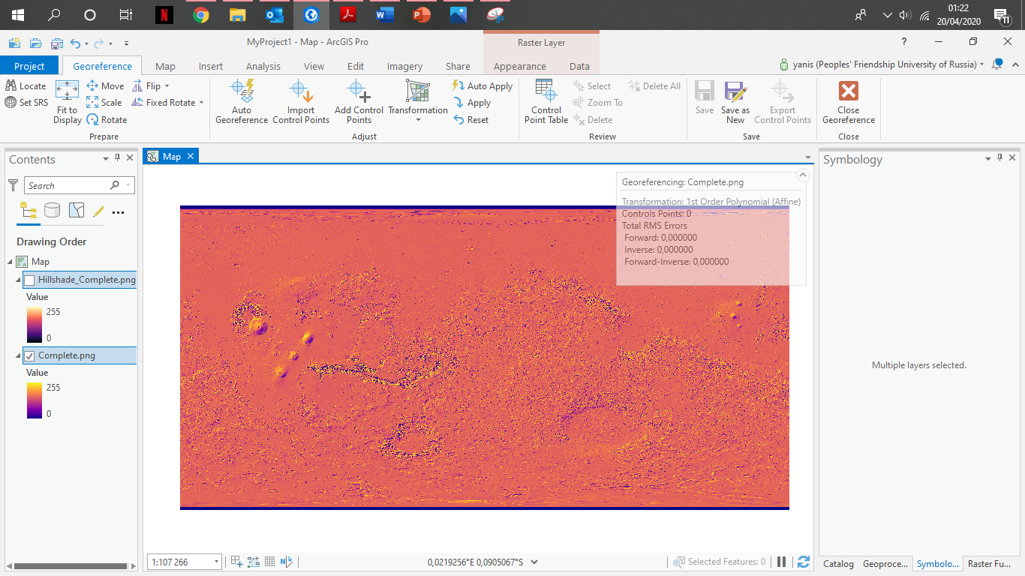
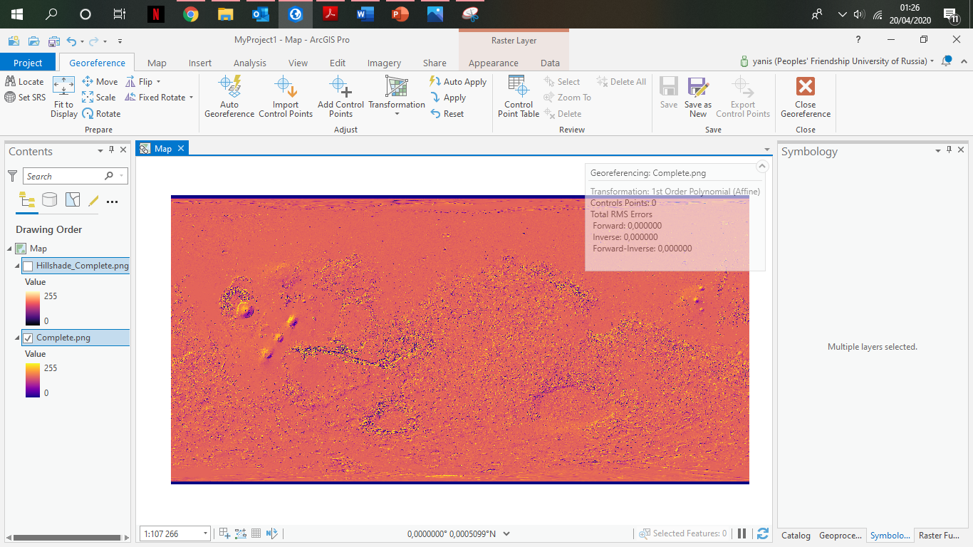

Raster operation : georeference

Slide 11
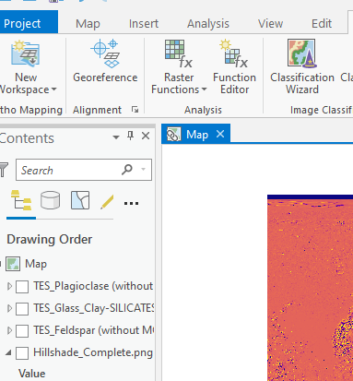
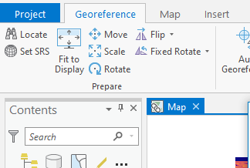
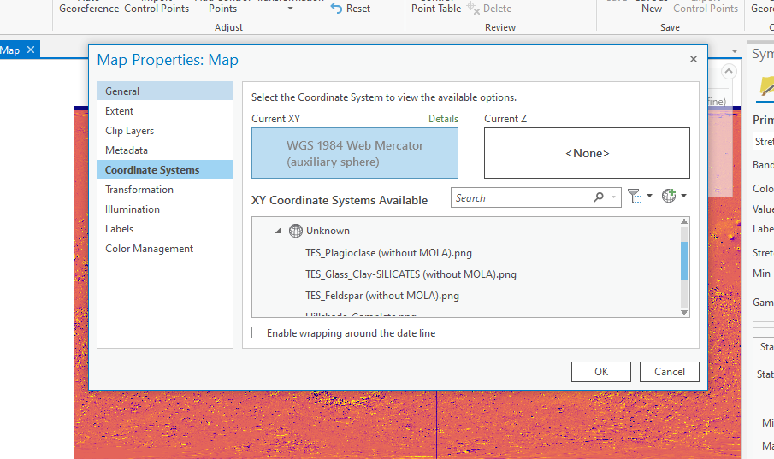

Slide 12
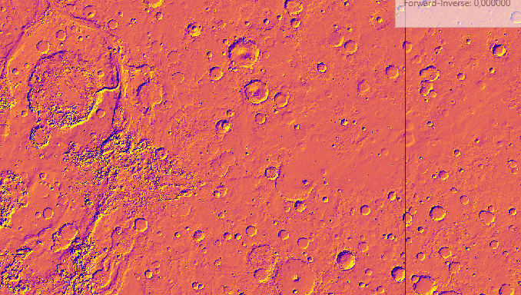
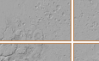
Raster operation : georeference
So we need to georeference the map in a better way

Slide 13
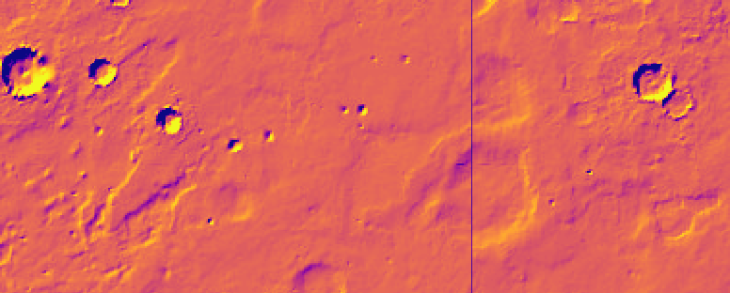
Edges of previous tiles, set to x=0 and y=0

Slide 14
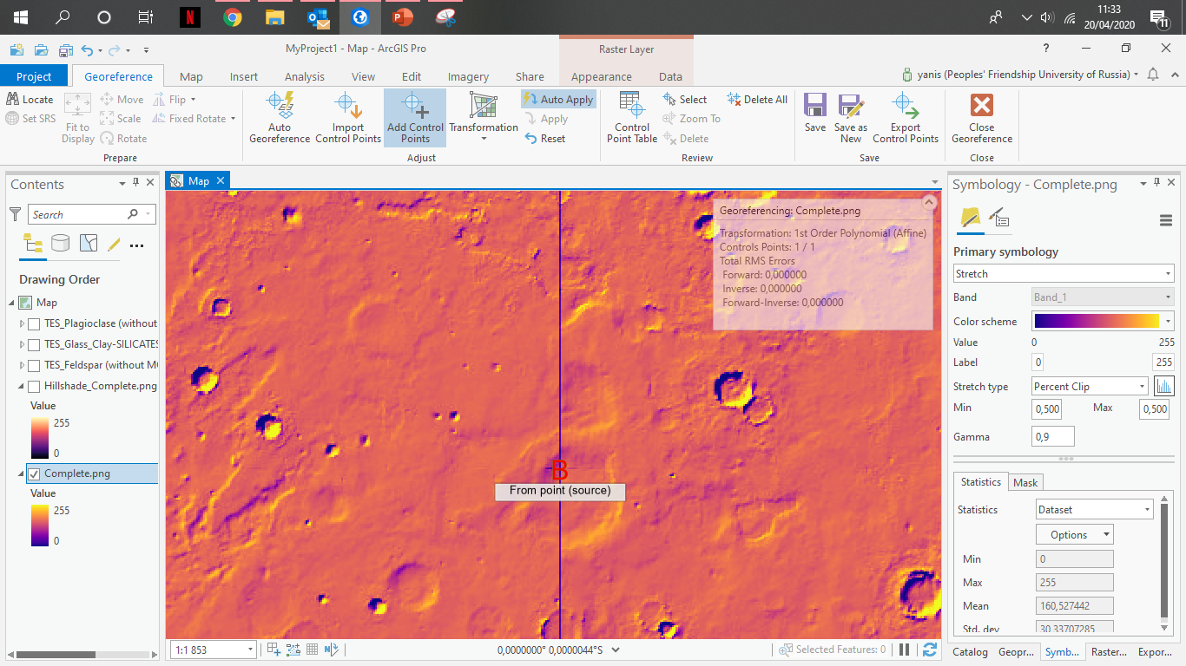
Now centered

Slide 15
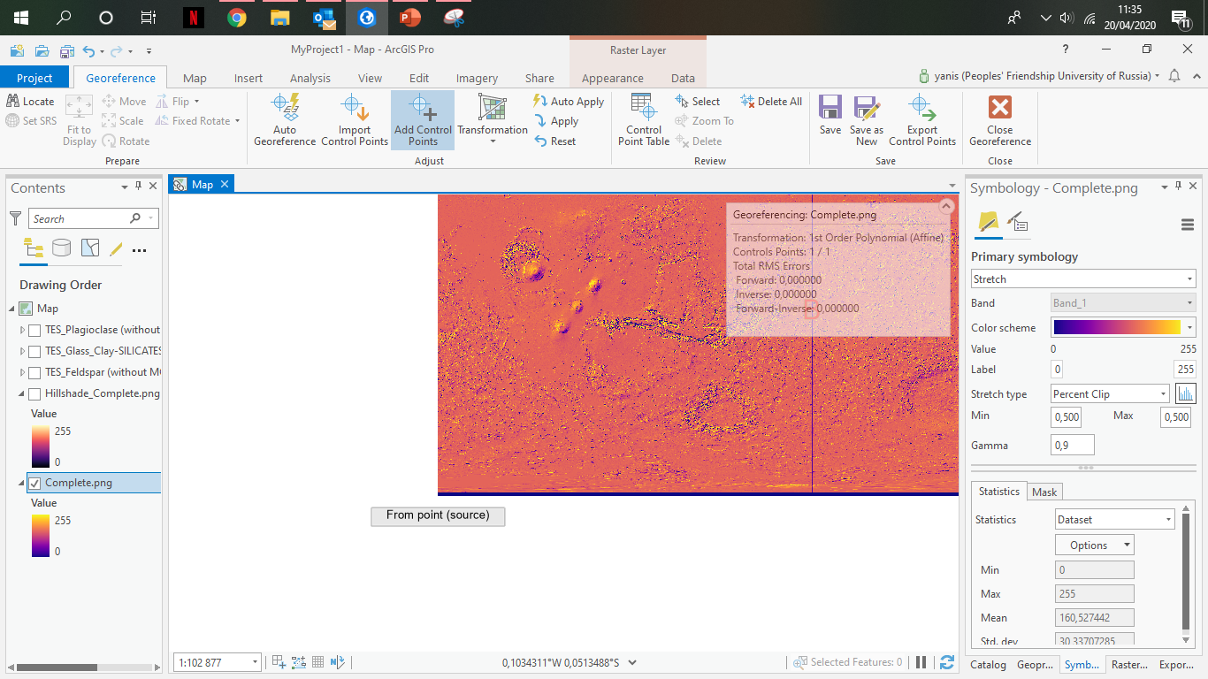
Far South-West, should be -90°S and -180°W

Slide 16
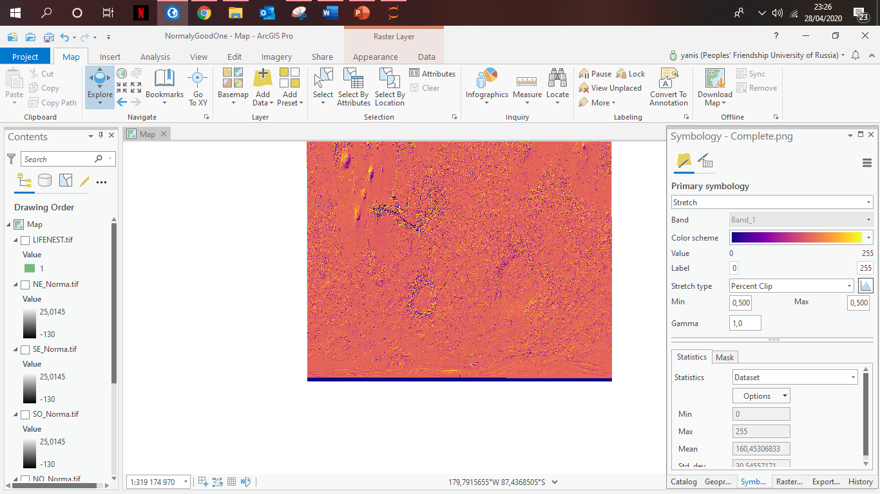
Far South-West, is now at -90°S and -180°W, same for all four corners

Slide 17
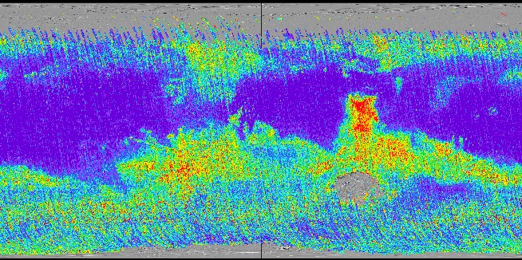
Same for the mineral's layers
PLAGIOCLASE
Georeferenced

Slide 18
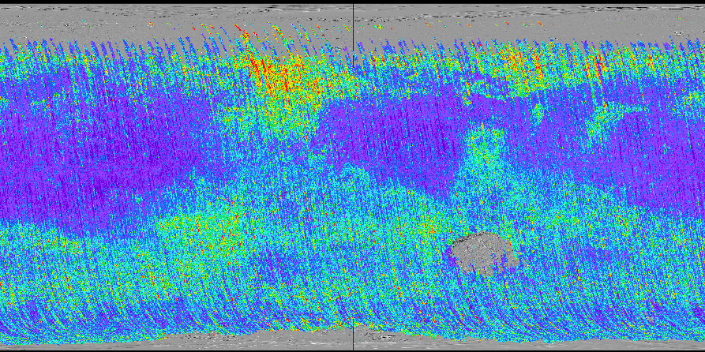
Exact same process for SILICATES
SILICATES
Georeferenced

Slide 19
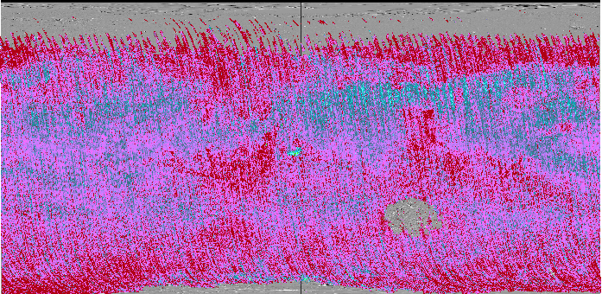
Exact same process for FELDSPAR
FELDSPAR
Georeferenced

Slide 20
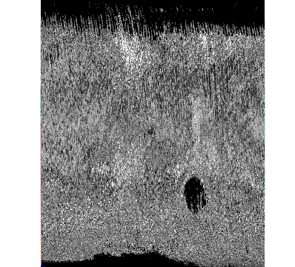

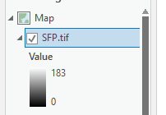
mineral preference of life
SFP map
Ex : 0,6
Ex : 0,25
Ex : 0,15

Slide 21
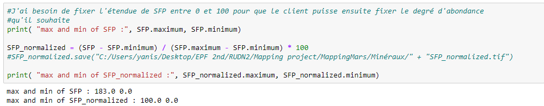
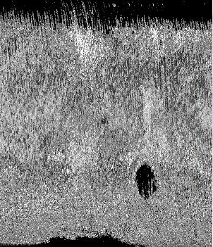
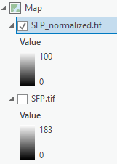
Raster operation : normalization

Slide 22
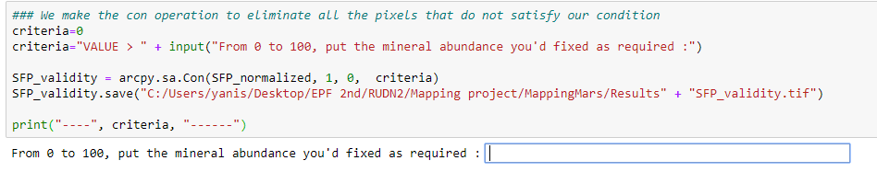
Raster operation : condition

Slide 23
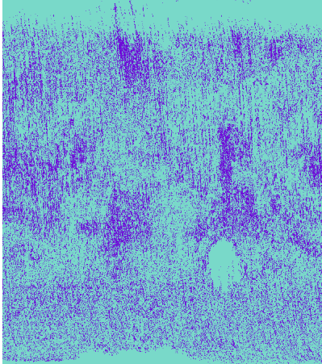
SFP map
SFP_validity(50) map

Slide 24
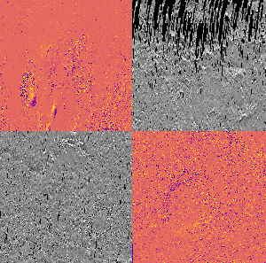
Temperature suitable for life
Temperature layer was too big
Impossible to normalize or apply cond
Separated in 4 quarters

Slide 25
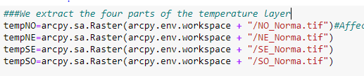
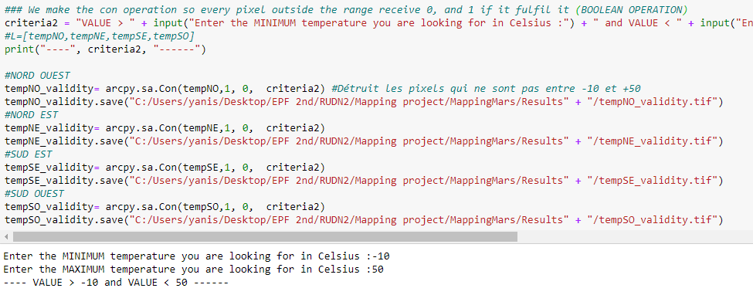
Raster operation : norm & cond
ArcGIS(default range) = [0;255]
Mars ’ temperature range = [-130°C;+25°C]

Slide 26
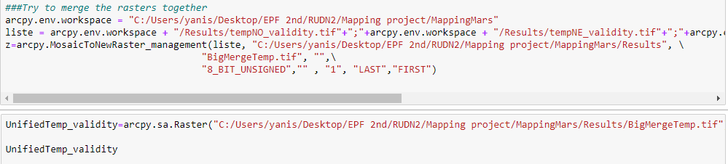

Slide 27
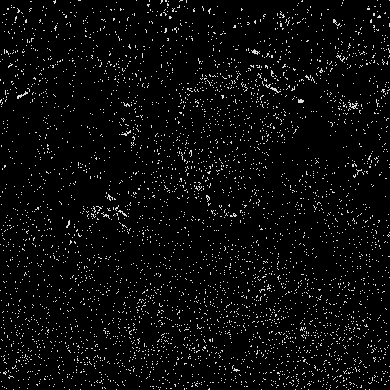
Each spot is a place where the temperature are inbetween [-10°C;+50°C]

Slide 28
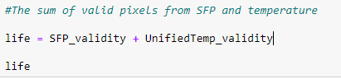
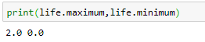
LIFE MAP – arithmetic raster op.
Reminder:
Pixel value = 1 ⬄ Satisfy the condition
Pixel value = 0 ⬄ Do not
Life map ⬄ Both condition are fulfiled
⬄ Pixel value = 2

Slide 29
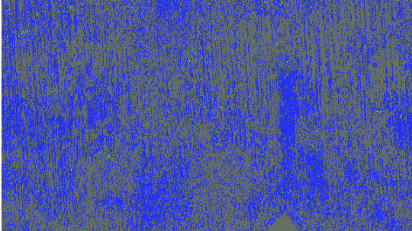
Arabia
Valles Marineris

Slide 30
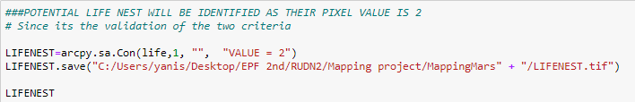

LIFE MAP – con operation

Slide 31
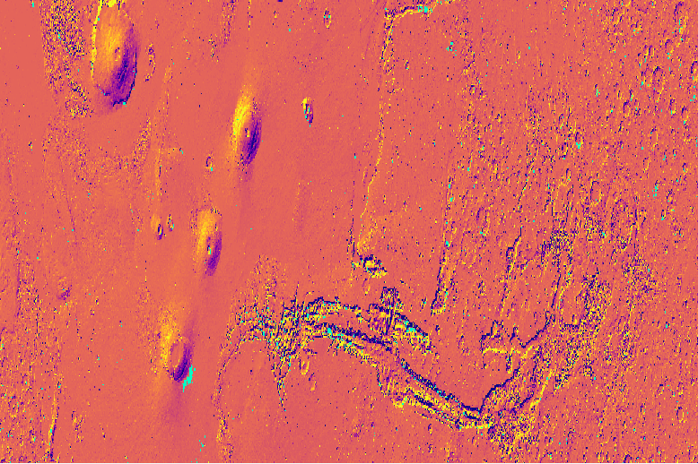
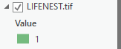
Potential life nests
Tharsis
Valles Marineris

Slide 32
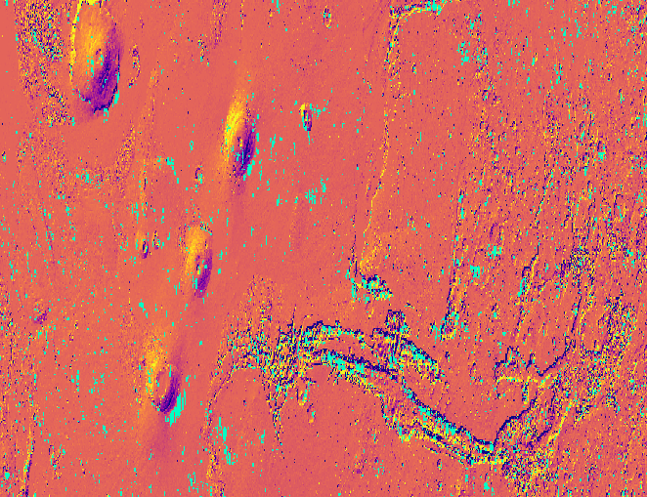
Tharsis
Tharsis
Valles Marineris
Valles Marineris
SFP (0.6-0.25-0.15)
Mineral’s abundance > 40%
Temperature range = [-10°C;+50°C]
SFP (0.6-0.25-0.15)
Mineral’s abundance > 40%
Temperature range = [- 35°C;+50°C]

Slide 33
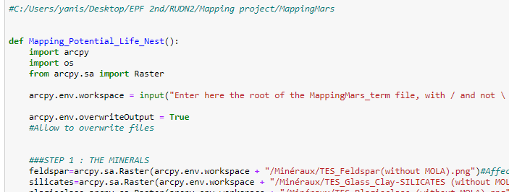
Potential life nests – generative code
etc…
LET’S GO FOR A LIVE TEST !

